Slide 1
Gui and Graphics
Beginnings of a Dice generator
By Ian Kinney

Slide 2
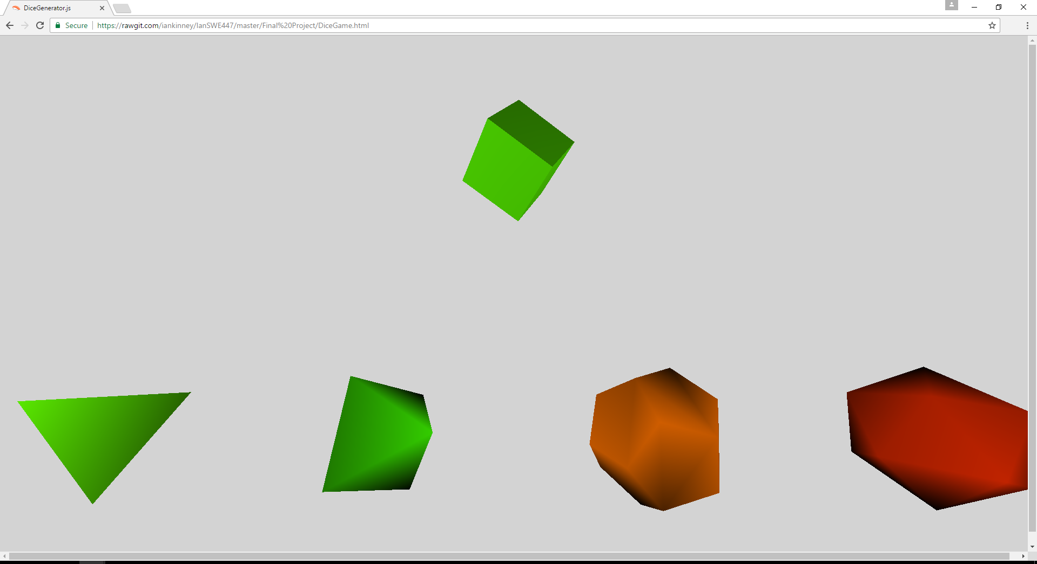
What exactly was my project?
My project started out as being a dice rolling generator
Because I had difficulties with three.js, I just decided to set up the basis for further work, and generate spinning dice of most of the standard DnD dice shapes.

Slide 3
Rewards and challenges
The most challenging task of creating this was initially getting three.js to work, then the wait time between each time I could refresh and get my new code working; the shapes, background, and other such were quite easy.
The most interesting task was learning that basic mesh material made it so that no vertices could really be seen, making it hard to tell certain shapes, and that Lambert colors needed a light.
What I would have done different is if I could have solved the three.js part done fast, actually adding a user interface to choose what dice they want to use, and how many of each dice, then set the scene to load new dice, or the type and amount chosen, then roll them.

